Slide 1









WORKSHOPS
Advanced RAG techniques: HyDE and Contextual Filtering
Paul Quigley
Insert headshot
Co-Founder & CEO
Zero Shot Labs

Slide 2

Table of Contents / Agenda
1
Introduction
Objective | About the Advanced RAG | Prerequisites
2
Technology Overview
20 minutes
3
Hands-on Exercise
20 minutes
4
Final Quiz
5
Q & A

Slide 3
Workshop Prerequisites
Basic Python programming experience
LangChain Experience
Basic familiarity with RAG

Slide 4


Tech Overview

Slide 5

Problem
Your RAG program isn’t doing what you’d like
Is unable to handle certain user queries
Sometimes misses important information that you know is in your source documentation
Users have been complaining, and it’s your job to fix this.

Slide 6
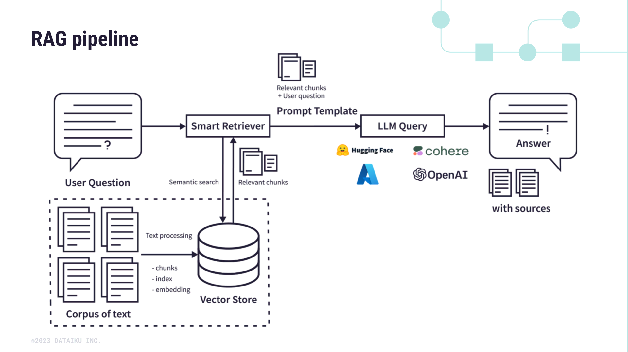
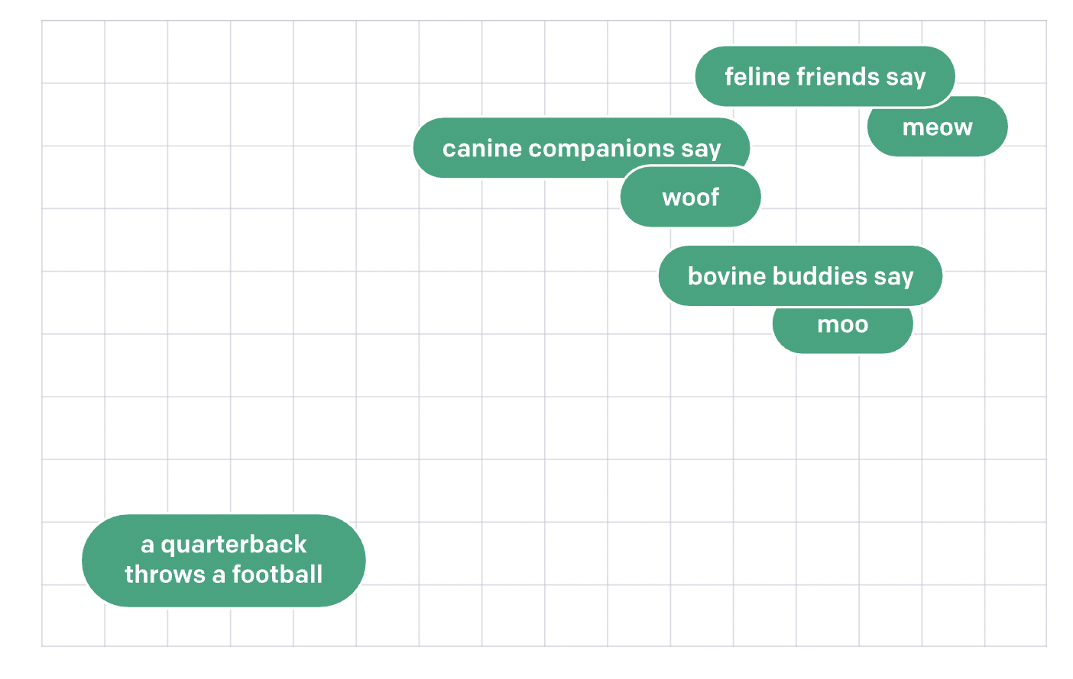
Why might these be failing?
Review of RAG
We pull information from our vector store based on the user’s query
The smart retriever likely uses a metric like cosine similarity
Not magic – no guarantee that the retriever pulls the right information

Slide 7
Failing query #2
User query: “What is the price of a soda at McDonald’s?”
RAG system might fail if the RAG pipeline pulls information about the price of other items or if it pulls a bunch of information about soda that isn’t related to price.
If you’ve used automated customer support systems where you ask a question and gives you back irrelevant information you probably understand the issue.

Slide 8
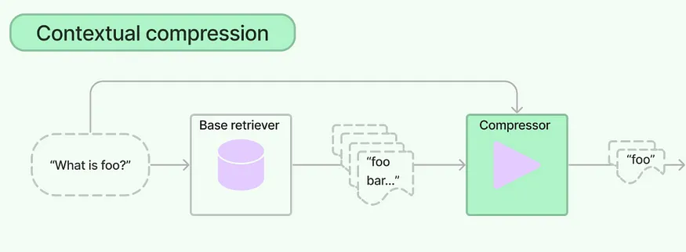
Technique #1
Contextual compression
Main idea: after you’ve retrieved documents, reuse prompts to rewrite documents to remove irrelevant pieces.
e.g., for our previous example “McDonald’s sodas include Coke and Sprite and recently raised their prices from $.99 to $1.25.” we would extract only the relevant portion “McDonald’s raised their prices from $.99 to $1.25”
Filters are similar except for removing irrelevant documents entirely.

Slide 9
Code demo!
http://tinyurl.com/ZSL-advanced-rag

Slide 10
Final Exercise

Slide 11
Final Exercise - Build a GPT!
Follow along with the worksheet:
http://tinyurl.com/ZSL-advanced-rag

Slide 12
Quiz Time!

Slide 13
Quiz Time!
Q1. Why can HyDE improve RAG performance?
A. Increasing computational power of the system
B. Giving more context for our retriever to match text
C. Providing training example to create a more accurate encoder
D. Completely eliminating hallucinations

Slide 14
Quiz Time!
Q1. Why can HyDE improve RAG performance?
A. Increasing computational power of the system
B. Giving more context for our retriever to match text
C. Providing training example to create a more accurate encoder
D. Completely eliminating hallucinations

Slide 15
Quiz Time!
Q2. Why can contextual compressors improve RAG performance?
A. Increasing the number of semantic features in RAG
B. Reducing the dimensionality of the input vectors
C. Ensuring the LLM only receives essential information
D. Capture nonlinear relationships between key ideas

Slide 16
Quiz Time!
Q2. Why can contextual compressors improve RAG performance?
A. Increasing the number of semantic features in RAG
B. Reducing the dimensionality of the input vectors
C. Ensuring the LLM only receives essential information
D. Capture nonlinear relationships between key ideas

Slide 17
Quiz Time!
Q3. How do filters differ from general contextual compressors?
A. Filters store the entire document
B. Filters work only on pre-processed data
C. Filters work only on exact matches for a given query
D. Filters provide a “YES/NO” about whether a document is relevant

Slide 18
Quiz Time!
Q3. How do filters differ from general contextual compressors?
A. Filters store the entire document
B. Filters work only on pre-processed data
C. Filters work only on exact matches for a given query
D. Filters provide a “YES/NO” about whether a document is relevant

Slide 19
Quiz Time!
Q4. What inputs does LangChain’s HyDE class require upon construction?
A. A base embedder and a prompt chain to generate the hypothetical document
B. A base embedder and a list of keywords
C. A python runnable chain and a list of keywords
D. A list of documents

Slide 20
Quiz Time!
Q4. What inputs does LangChain’s HyDE class require upon construction?
A. A base embedder and a prompt chain to generate the hypothetical document
B. A base embedder and a list of keywords
C. A python runnable chain and a list of keywords
D. A list of documents

Slide 21
Quiz Time!
Q5. Which inputs are required to create a contextual compression retriever in langchain?
A. A base compressor and a base retriever
B. A list of documents and a retriever
C. A list of documents and a compressor
D. A series of prompt chains with instructions on compression

Slide 22
Quiz Time!
Q5. Which inputs are required to create a contextual compression retriever in langchain?
A. A base compressor and a base retriever
B. A list of documents and a retriever
C. A list of documents and a compressor
D. A series of prompt chains with instructions on compression

Slide 23
Q & A

Slide 24
Thank You!
pquigley@zeroshotlabs.com

